Slide 1

Kickstarter Oracle
Kickstarting your kickstarter campaign

Slide 2
Content
Meet the team.
Understand the market.
Meet Kickstarter-Oracle
Commercial viability.
Technological overview.

Slide 3
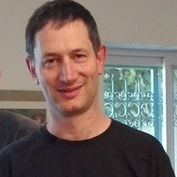
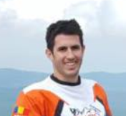
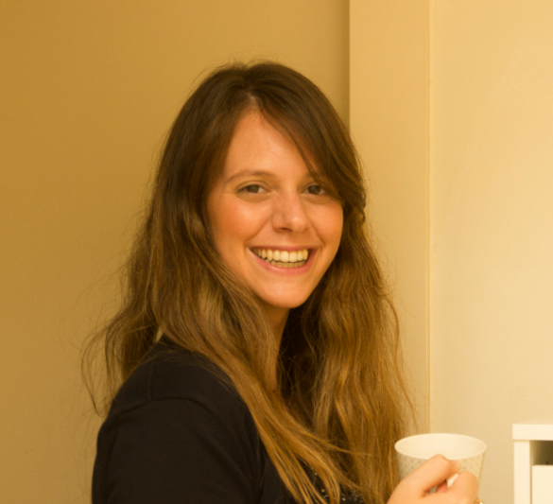
The Team
Elad Toister
CTO
Yotam Nahum
COO
Aviv Alfandary
CEO

Slide 4
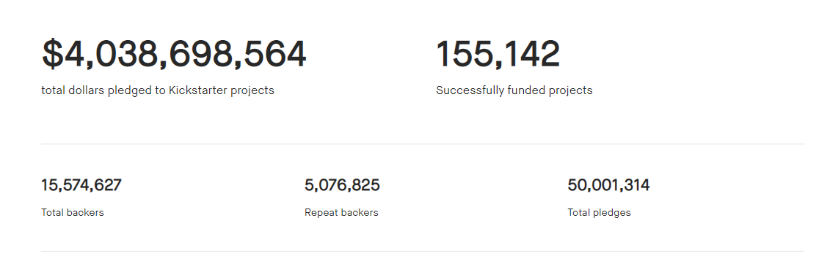
Understand the market- kickstarter example
Current funding success rate (Kickstarter) ~36%

Slide 5
Kickstarter oracle Mission statement
Kickstarter-oracle (KO) shall provide it’s customers with highly beneficial insights for improving their funding campaign. Leveraging AI technology and past campaign information KO shall play a fundamental role in it’s customers funding success.
Our success criteria : KO customers funding success rate >72%.

Slide 6
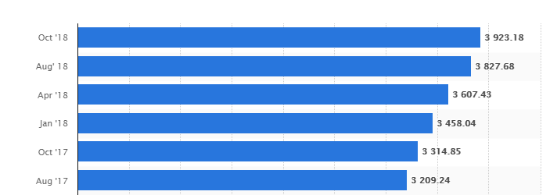
Kickstarter oracle – commercial viability
KO shall charge it’s customers a 1% commission of money pledged (for successful campaign).
Based on a 10% initial adoption rate KO expected monthly income ~$50K (based on KS Oct 2018 funding statistics)
Funds pledged for kickstarted projects ($M)

Slide 7
Data handling
Initial data: 205K cases, 45 attributes, 55 data files
Data preparation activities:
Phrasing of a category column.
Split date columns into single columns per day/month/ year
Turn success/fail data into numerical
Drop missing creator lines
Data after handling: 171K cases 38 attributes

Slide 8
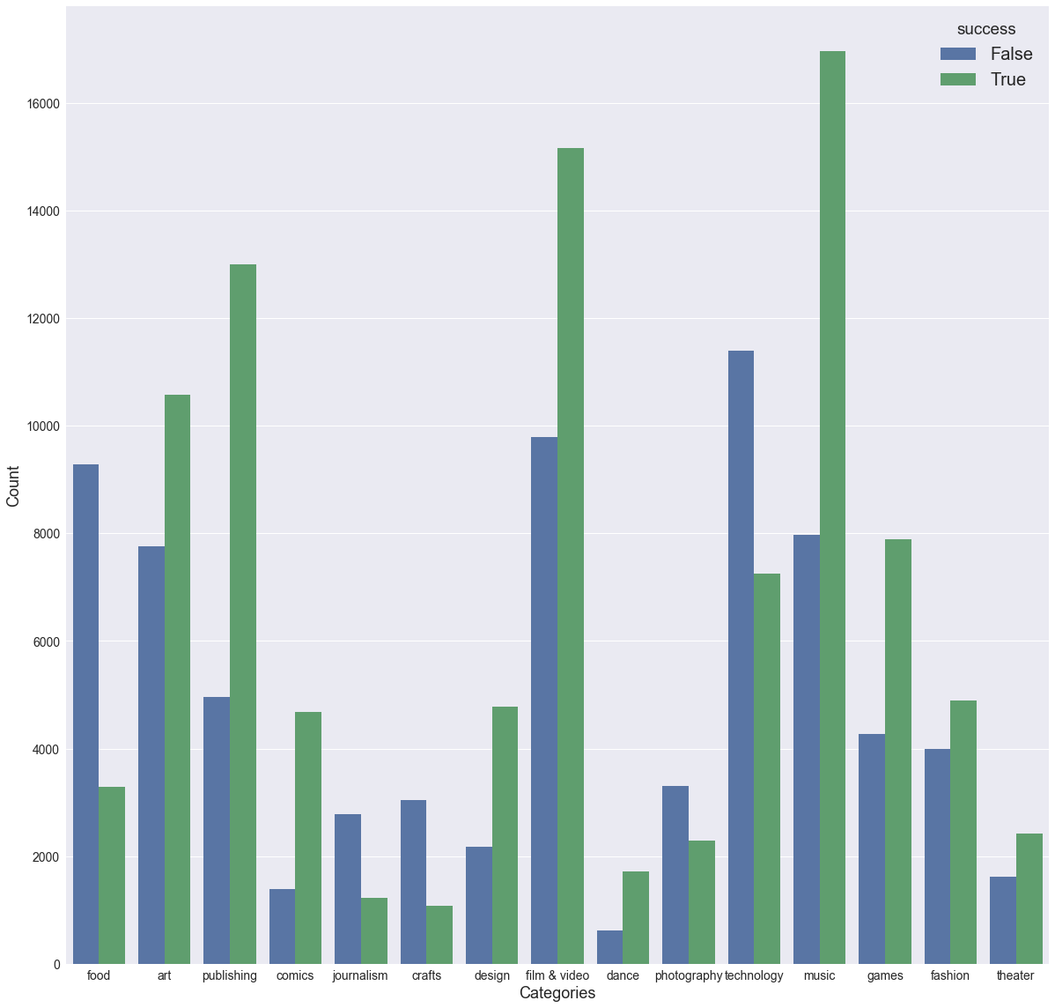
Initial observations
Clear bias towards publishing, “film and video” and music projects.
High correlation factors between success and:
Category 0.32
Staff pick 0.26

Slide 9
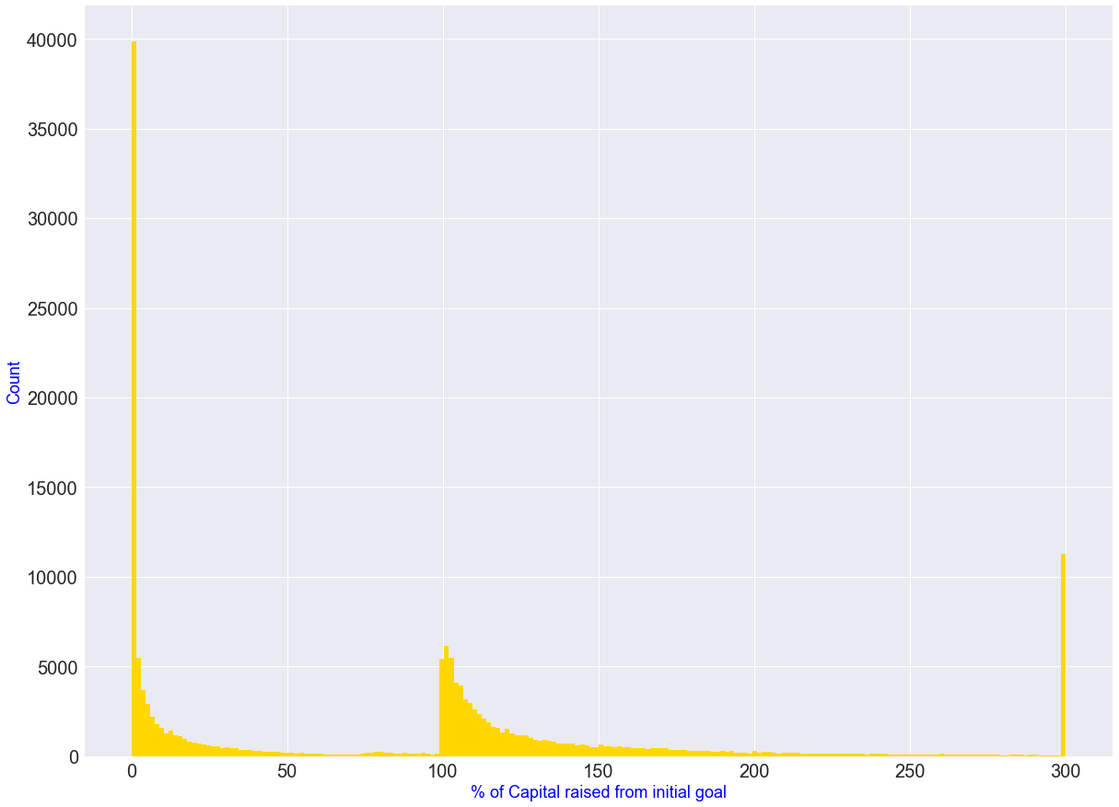
Initial observations- Continued
Most failures are attributed to lack of interest and not a funding failure
Successes distribute exponentially from target (i.e. target could have been set higher?)
Need to understand outliers

Slide 10
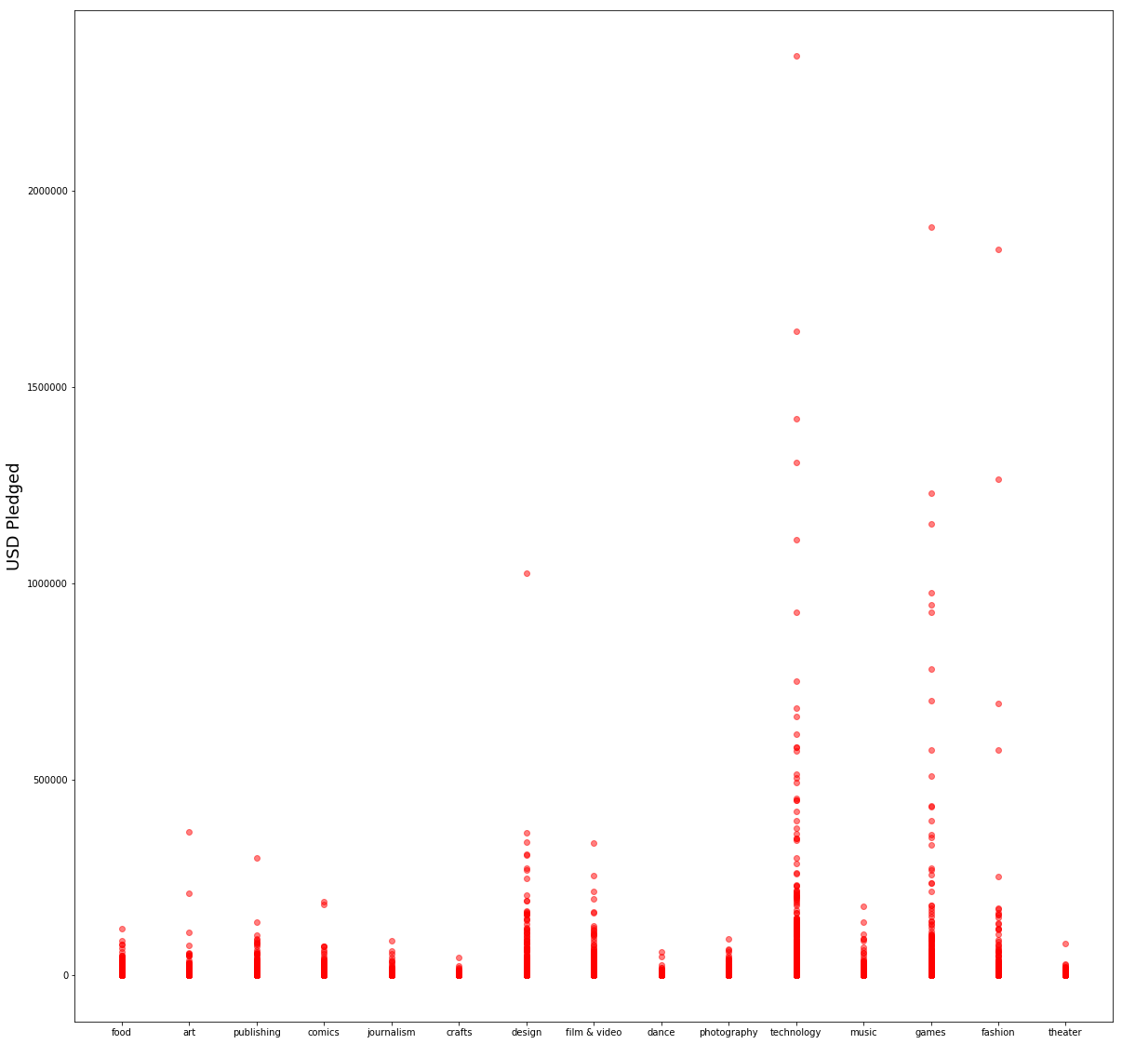
Pledged capital per area
High $ pledge projects :
Tech.
Games.
Fashion

Slide 11
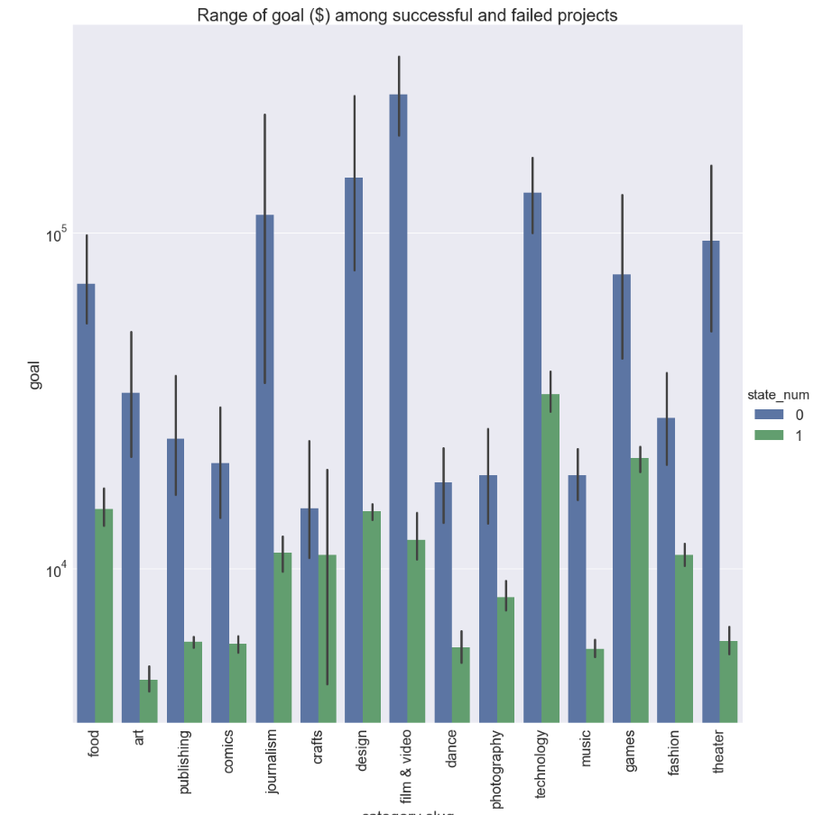
Capital raise Goal per category
Unsuccessful project were aiming too high!

Slide 12
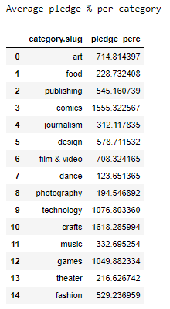
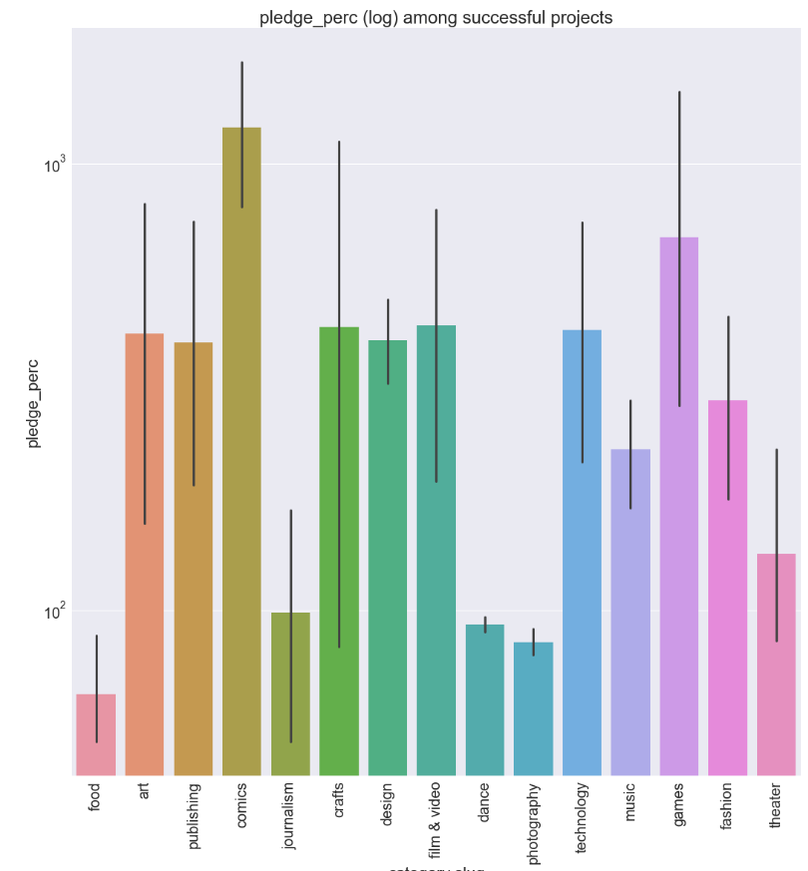
Capital raised/goal (pledge %) per category
Data presents an option to help the customer define the pledge goal per his real needs.

Slide 13
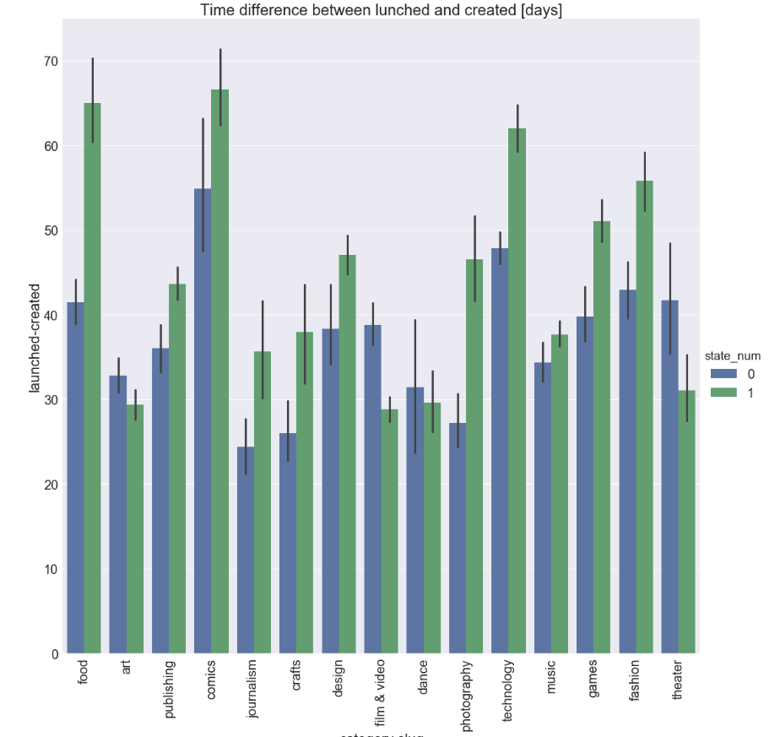
Launch Timing Advice
Most categories (*) are clearly biased towards a longer “promotion” period
*Excluding film & video and Theater

Slide 14
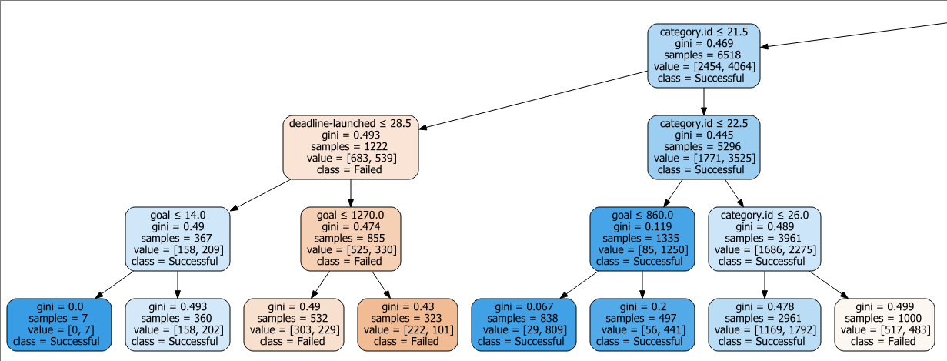
Decision Tree
Tree parameters (X):
Goal
Deadline-launched
Launched-created
Staff pick
Category
Target parameter- funding success (Y)

Slide 15
Decision Tree
Results for a 10 level tree over ~95K lines:
The recall for the train set is 0.777975201823
The recall for the test set tree is 0.777664300669
The precision for the train set tree is 0.81356959162
The precision for the test tree is 0.810354919385
Need to address the threshold and what is better- recall or precision for this app

Slide 16
Path forward
Apply better AI models for investigating existing KS data
Find additional data for augmenting the KS data.
Investigate the option to use Google Trends API for collecting “post funding” success data for gaining additional insights on success rate.

Slide 17

Thank You

